Slide 1


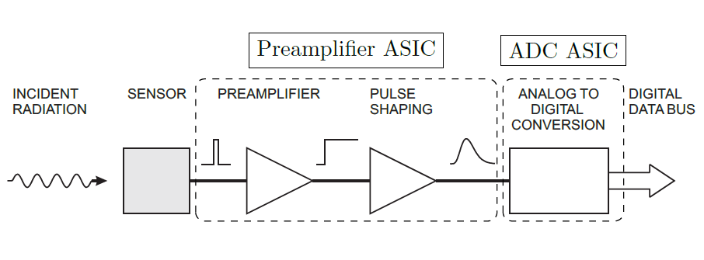
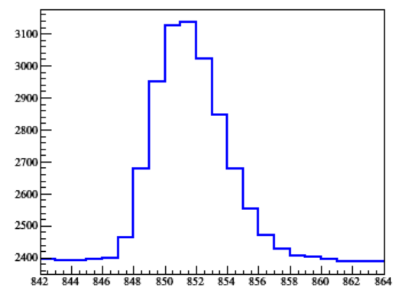
ADC Calibration in LArTPC
WIRE SIGNAL
Wenqiang Gu, Brookhaven National Laboratory
for the DUNE collaboration
Workshop on Calibration and Reconstruction for LArTPCs
December 10th 2018

Slide 2
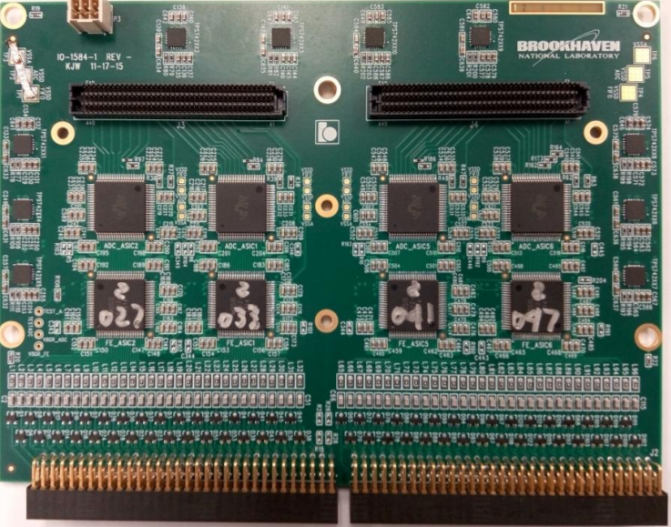
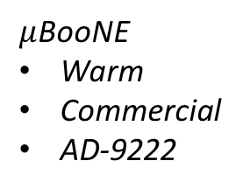
Evolution of ADC in LArTPC
$μ$BooNE
Warm
Commercial
AD-9222
protoDUNE
Cold
Non-commercial
“domino” P1
SBND
Cold
Commercial
AD7274
DUNE
Cold
Non-commercial
???
?
Cold ADC is essential for DUNE

Slide 3
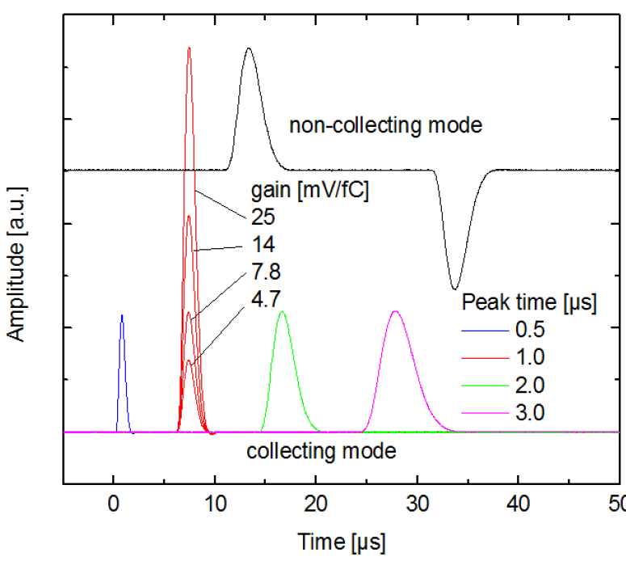
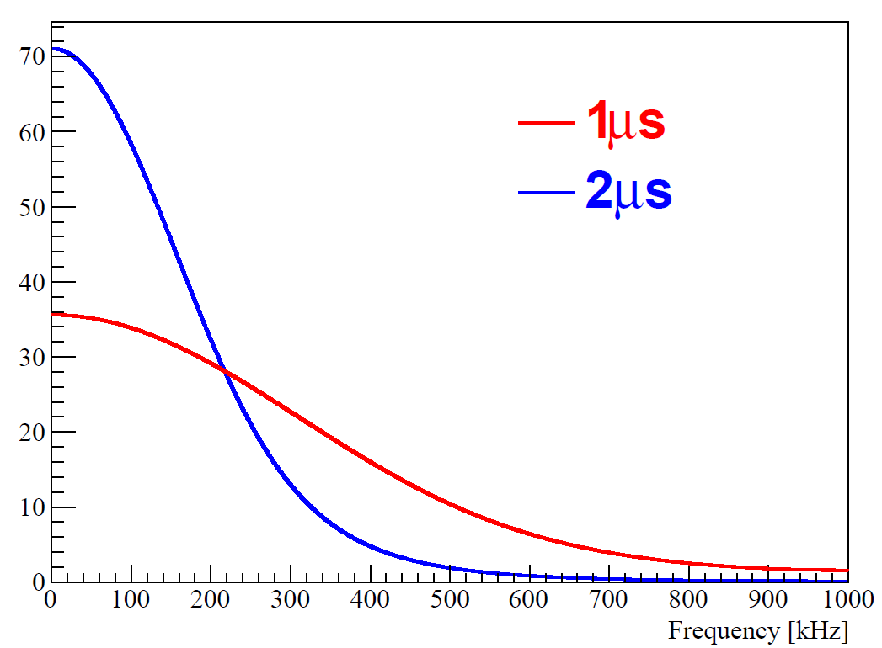
How to choose an ADC?
V. Radeka et al. Cold electronics for ‘Giant’ Liquid Argon Time Projection Chambers,
J. Phys. Conf. Ser. 308 (2011) 012021
protoDUNE: 14 mv/fC + 2.0 µs
Dynamic range
300 fC maximum ionized charge, 0.1 fC noise → 12-bit ADC
Preamp gain 4.7 mV/fC → ADC 0 ~ 1.6V
Digitization frequency
Nyquist theorem: 1 MHz for 2us shaping
2 MHz oversampling is helpful for improving resolution, sticky code mitigation, etc.
Frequency spectrum for different shaping time

Slide 4
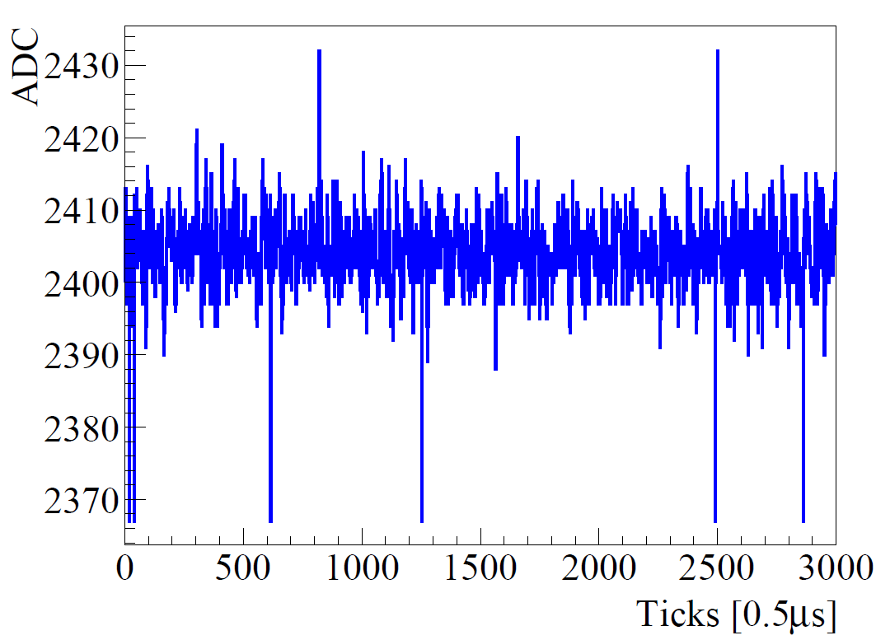
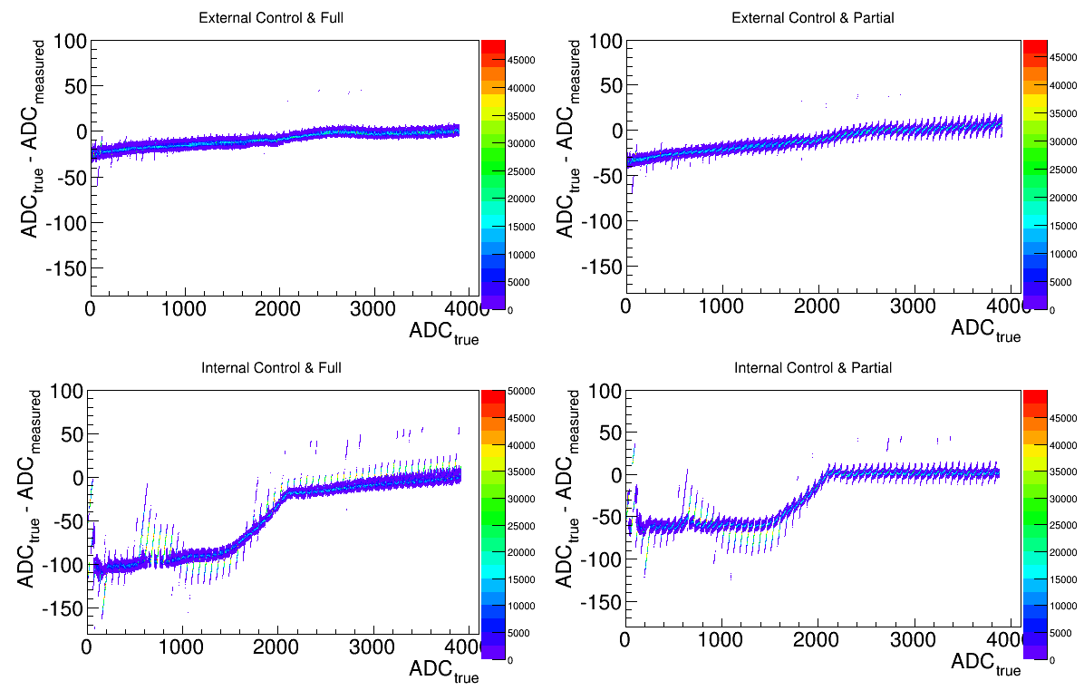
Precise ADC determination in protoDUNE
However, given the cold environment in LAr, two problems occur for the precise determination of ADC
2432
= (100110 000000)₂
ADC Sticky Code
ADC Nonlinearity
2367
= (100100 111111)₂

Slide 5
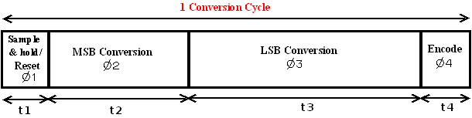
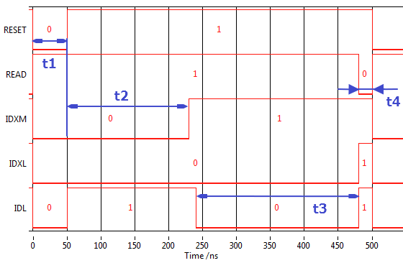
ADC readout scheme in protoDUNE
Read/write logic synchronized through five control signals
In cold environment, an instability in bit conversion results in sticky code and nonlinearity

Slide 6
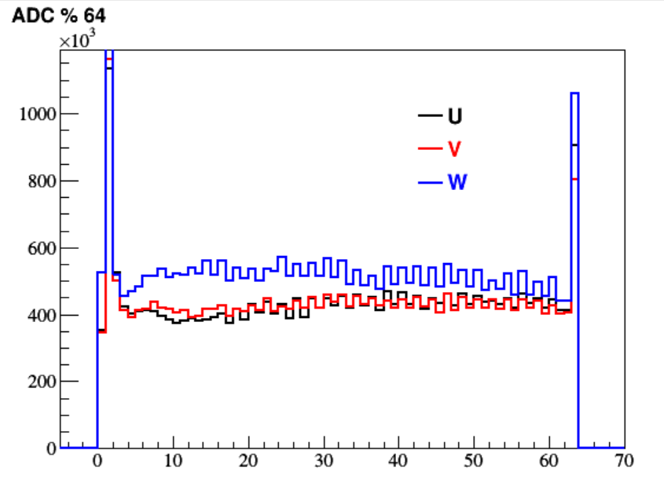
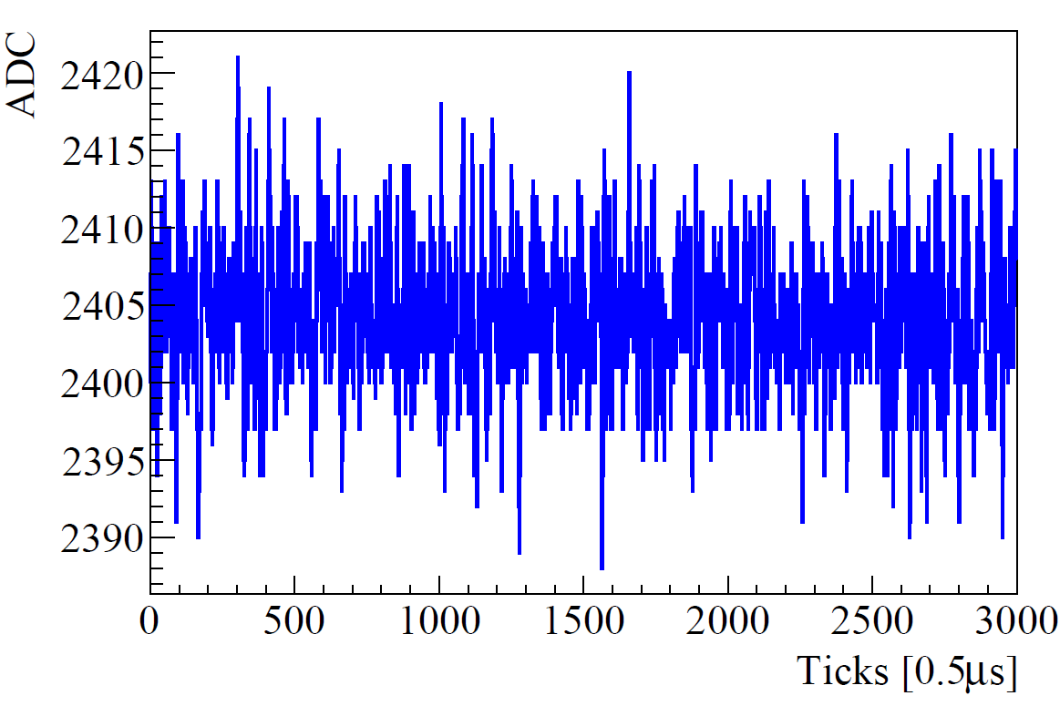
Procedure of sticky code mitigation
Identify sticky code:
ADC % 64 = 0, 1, 63, …
Interpolate the ticks with near-by “non-sticky” ticks
Veto sticky code candidates
X
X
X
X
X
X
X

Slide 7
Sticky code interpolation
Linear interpolation between “un-sticky” codes is a good first step
2 MHz oversampling is helpful for interpolation
However, linear interpolation may not be sufficient for signal region
A correction w.r.t. the electronics response function would be better
Linear interpolation
W.r.t response function

Slide 8
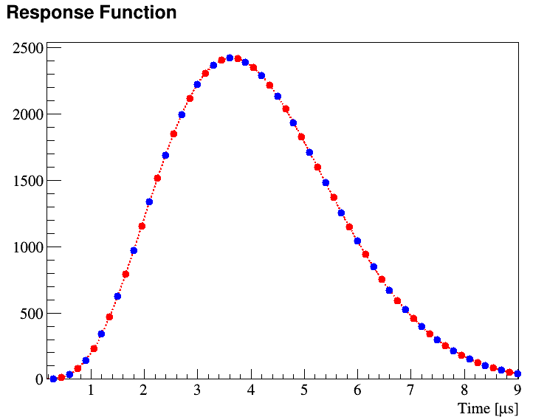
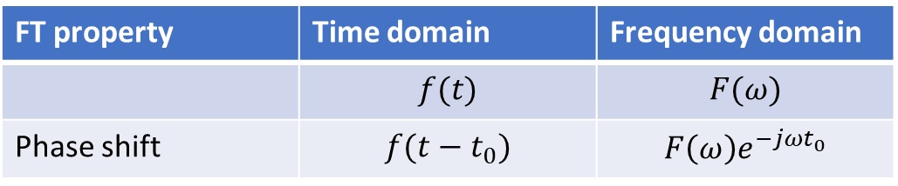
FFT interpolation w.r.t electronics response
However, some facts makes it difficult for using the response function
A few percent channel-to-channel variation in response function
Coupled with ADC nonlinearity (discussed shortly)
Instead, a FFT interpolation is proposed by
i) Linear interpolation as a base correction
ii) Once a “sticky” code found in an even-binned tick, apply phase shift to odd-binned ticks to cover even-binned ticks, and vice versa
FT property | Time domain | Frequency domain
 | $$f(t)$$ | $$F(ω)$$
Phase shift | $$f(t−t_{0})$$ | $$F\left(ω\right)e^{−jωt_{0}}$$
Example: red waveform interpolated from blue

Slide 9
Advantages of such FT interpolation
Only the phase changed, while no changes of the magnitude in the frequency domain
Still respect the shape of the electronics response function
Sometimes, good code tagged as “sticky”, the FT interpolation presumably minimize the biases
Balance of efficiency and accuracy for sticky code tagging

Slide 10
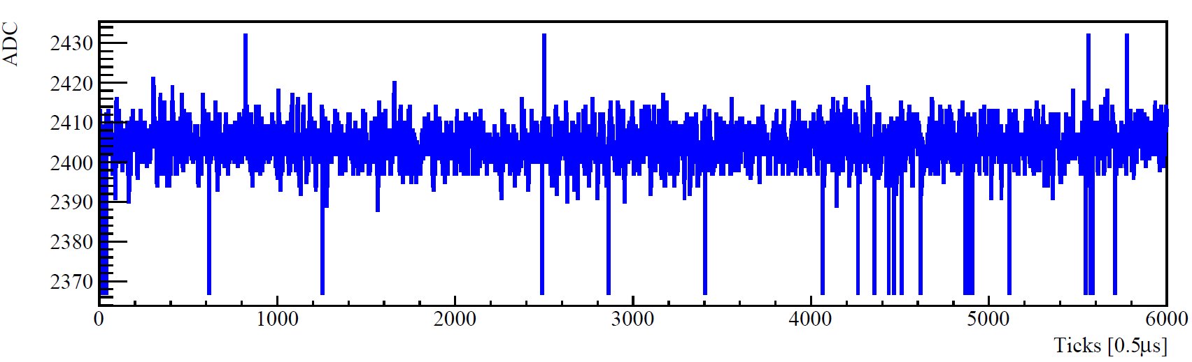
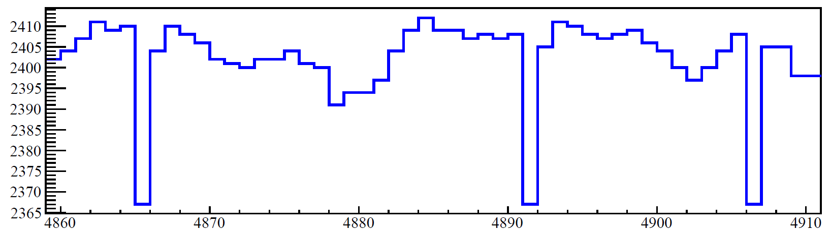
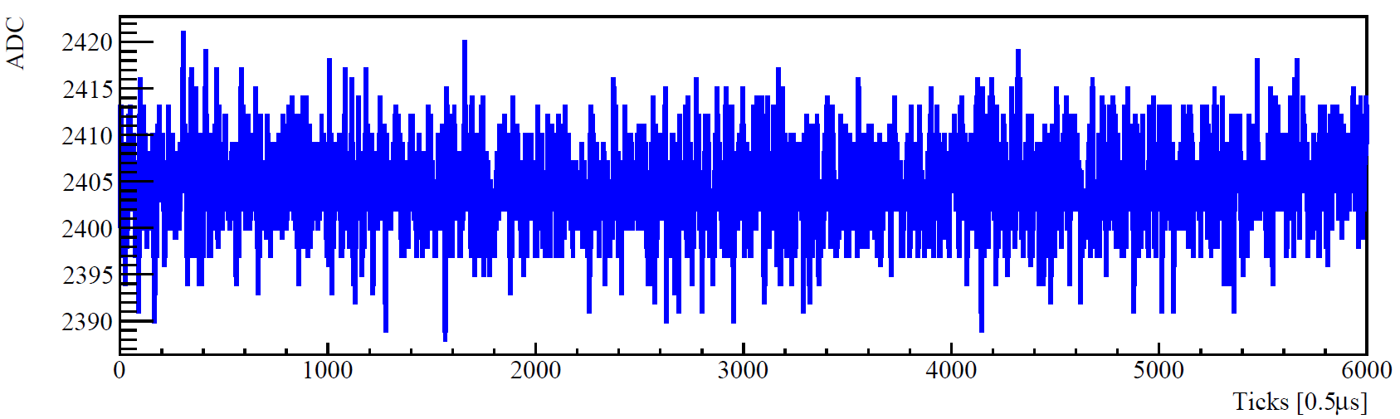
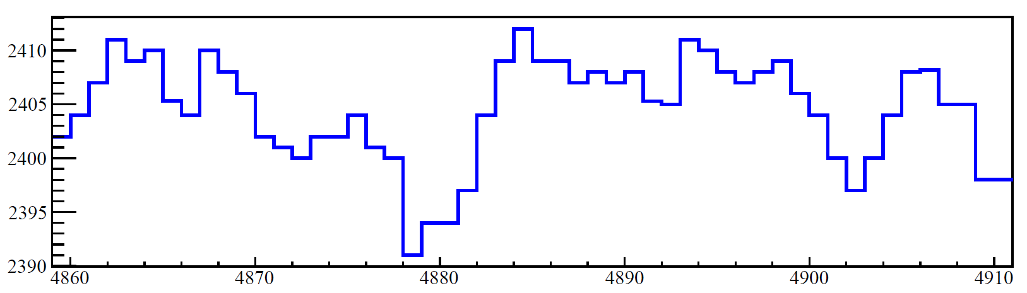
Performance of the ADC mitigation
Before mitigation
Sticky code
After mitigation
Interpolation

Slide 11
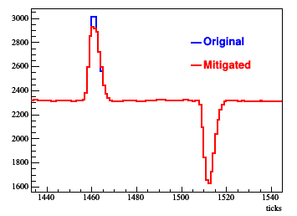
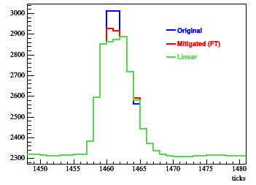
A special case
Sticky at 3008 = (101111 000000)₂
Preamp pulser waveform
Zoom-in
However, when two adjacent sticky codes happens on the peak region, the mitigation does not work well
Need to improve this special case
Maybe ignore the base correction from linear interpolation

Slide 12
ADC nonlinearity (NL)
Sticky code at 0
Low temperature degrades the electronics and read/write logics
External clock eases NL as well as sticky code
NL is sensitive to clock settings
A precise determination of ADC NL is very important for the extraction of ionized electrons
noise
nonlinearity
Sticky code at 63

Slide 13
Sticky code at 0
Noise
Nonlinearity
Sticky code at 63

Slide 14
Difficulties from a bench test to protoDUNE
NL is sensitive to clock settings
(bench test) clock is tuned for each ADC
(protoDUNE) one clock shared by four ADC circuits
Bench test
CALIBRATION SIGNAL
(KNOWN VOLTAGE)
ProtoDUNE
WIRE SIGNAL
No direct voltage input!

Slide 15
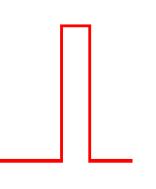
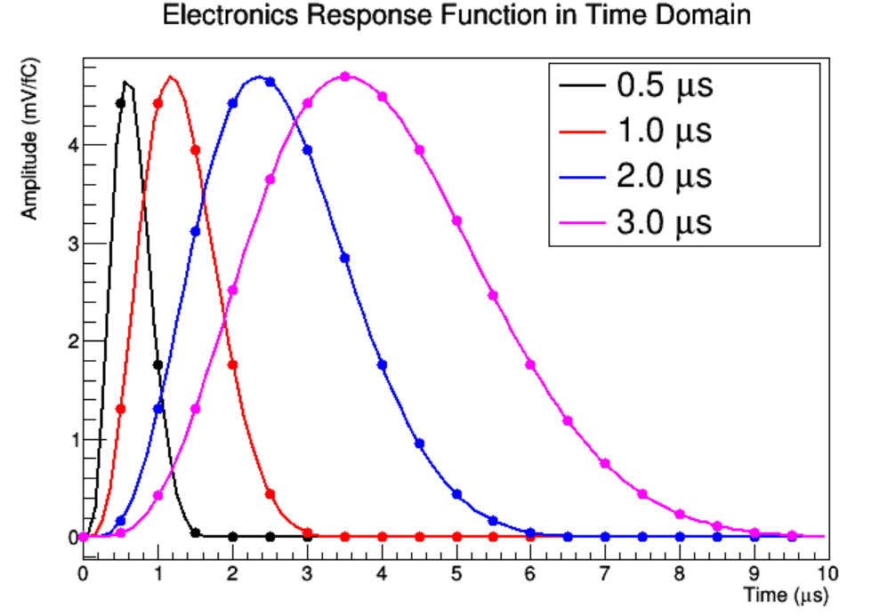
ADC calibration setup
C. Adams et al., Ionization Electron Signal Processing in Single Phase LArTPCs II. Data/Simulation Comparison and Performance in MicroBooNE
arXiv:1804.02583
Pulser
Voltage * 64
0 ~ 1.4V
Preamplifier
Gain *4
Shaping *4
Waveform measurement
ADC nonlinearity
Similar setup as in MicroBooNE electronics calibration

Slide 16
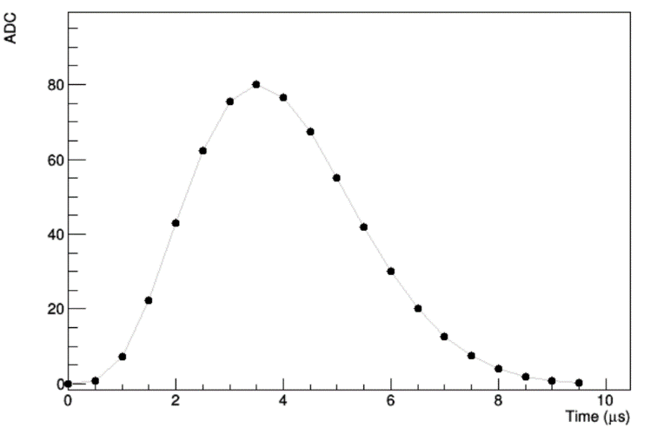
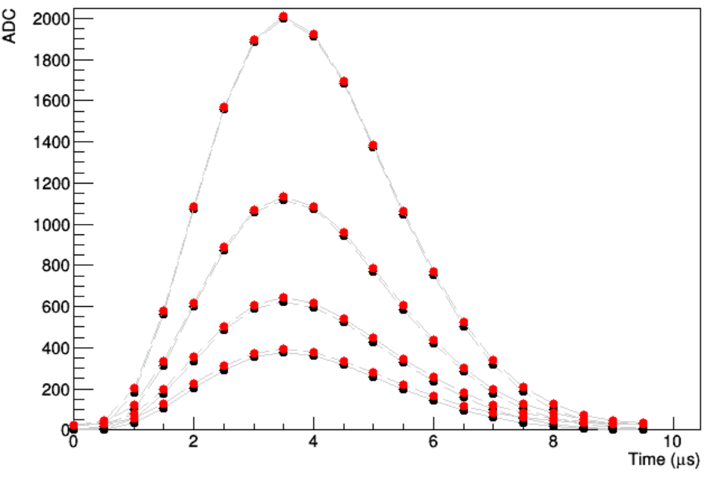
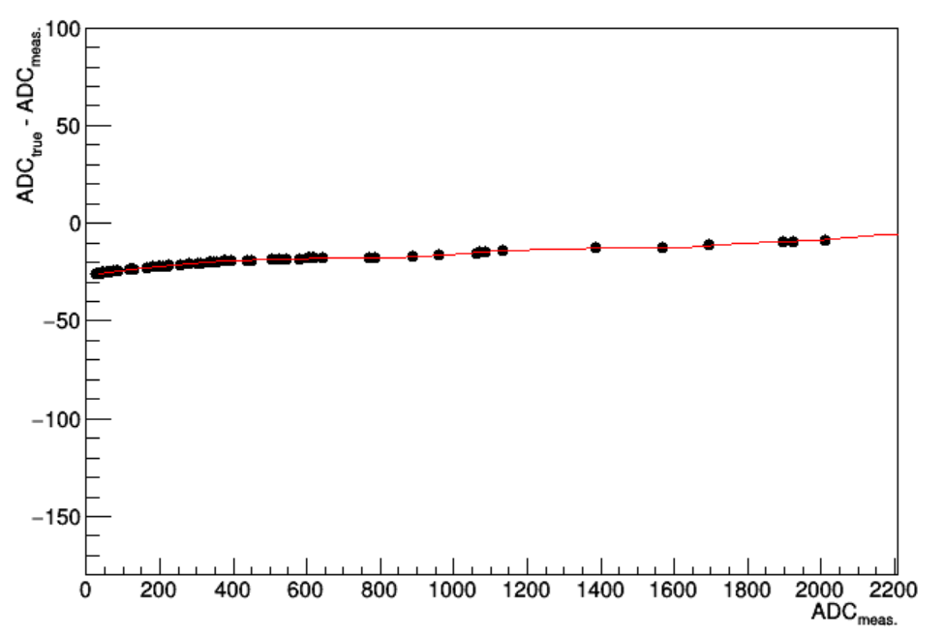
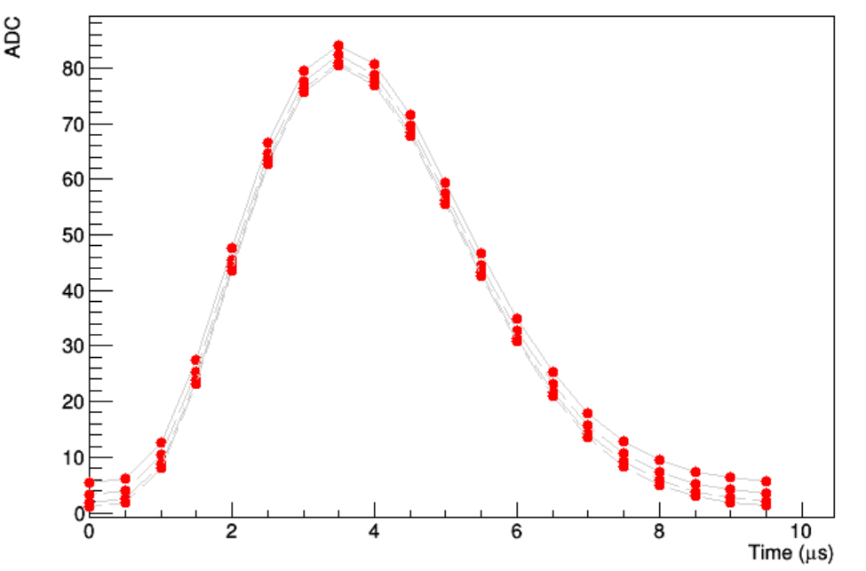
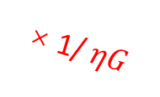
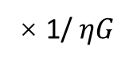
Calibration scheme independent of the shape of response function
Assume pulse voltage (η) and preamp gain (G) do not change the shape of electronics response
NL distorts the shape differently for high ADC and low ADC
true ADC
ADC_{measure}
ADC_{true}
× 1/ $ηG$
Waveforms match perfectly in shape
× 1/ $ηG$
with NL
A spread in shapes
Minimize it!
Input NL in MC

Slide 17
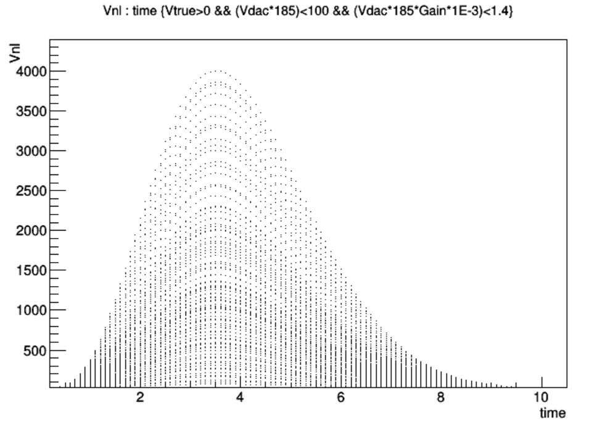
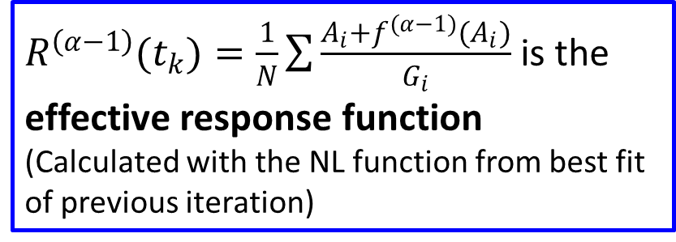
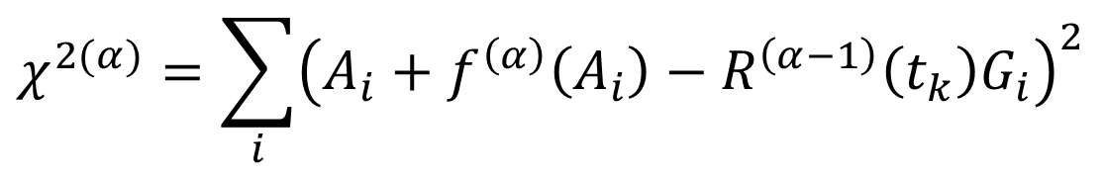
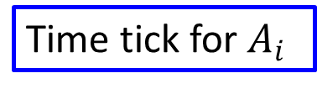
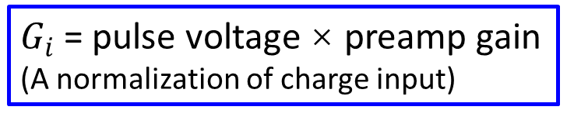
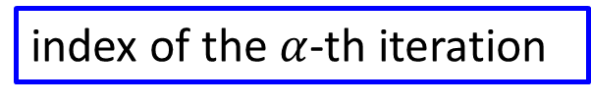
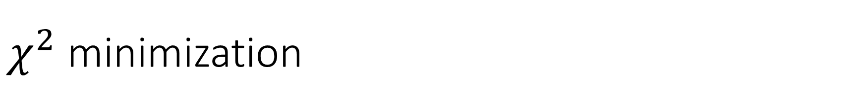
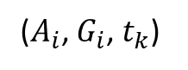
$χ^{2}$ minimization
($A_{i}$, $G_{i}$, $t_{k}$)
ADC_{measure}
$G_{i}$ = pulse voltage × preamp gain
(A normalization of charge input)
index of the $α$-th iteration
$$χ^{2(α)}=\sum_{i}{{\left(A_{i}+f^{\left(α\right)}\left(A_{i}\right)−R^{\left(α−1\right)}\left(t_{k}\right)G_{i}\right)}^{2}}$$
Time tick for $A_{i}$
$R^{\left(α−1\right)}(t_{k})=\frac{1}{N}\sum{\frac{A_{i}+f^{(α−1)}(A_{i})}{G_{i}}}$ is the effective response function
(Calculated with the NL function from best fit of previous iteration)
i-th data point
NL correction function
(To be fitted out)

Slide 18
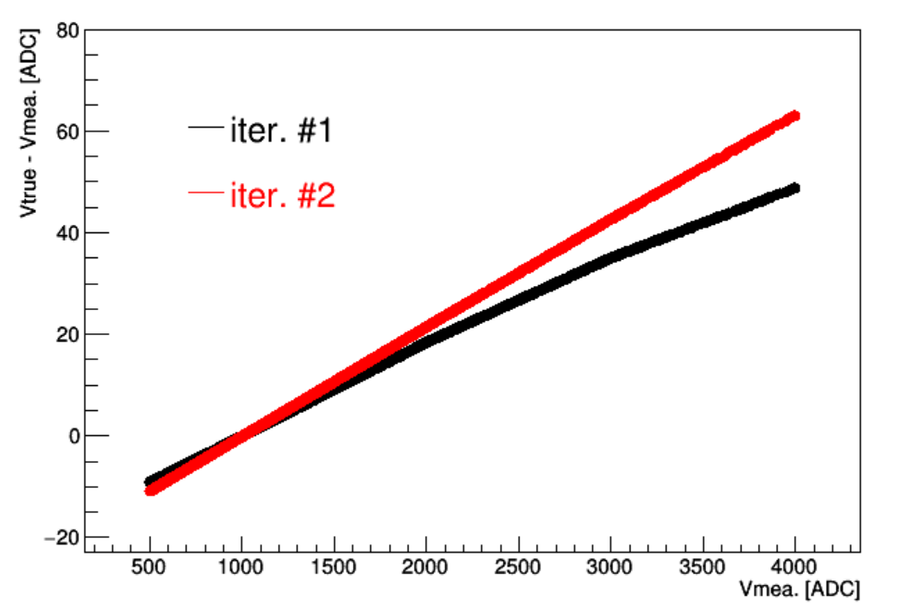
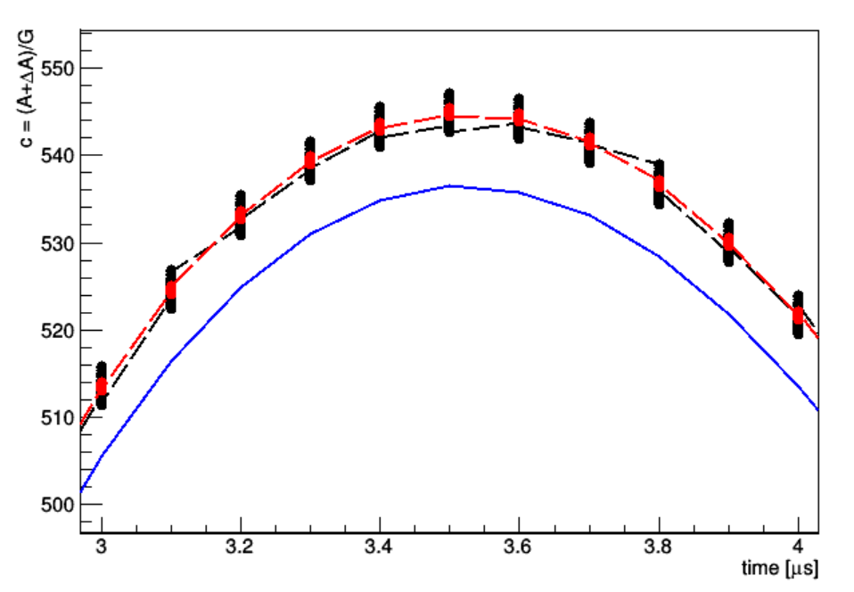
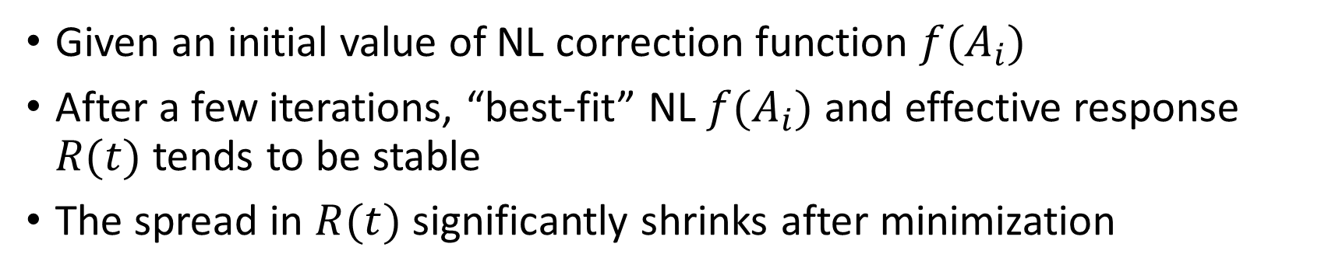

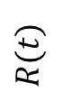
“Best-fit” $f(A_{i})$ and $R(t)$ from simulation
Given an initial value of NL correction function $f(A_{i})$
After a few iterations, “best-fit” NL $f(A_{i})$ and effective response $R(t)$ tends to be stable
The spread in $R(t)$ significantly shrinks after minimization
$R(t)$
Iter. #1
Iter. #2
ADC_{true} – ADC_{measure}
NL bias?
True
Electronics response bias ≈ 9
Initial
True
ADC_{measure}

Slide 19
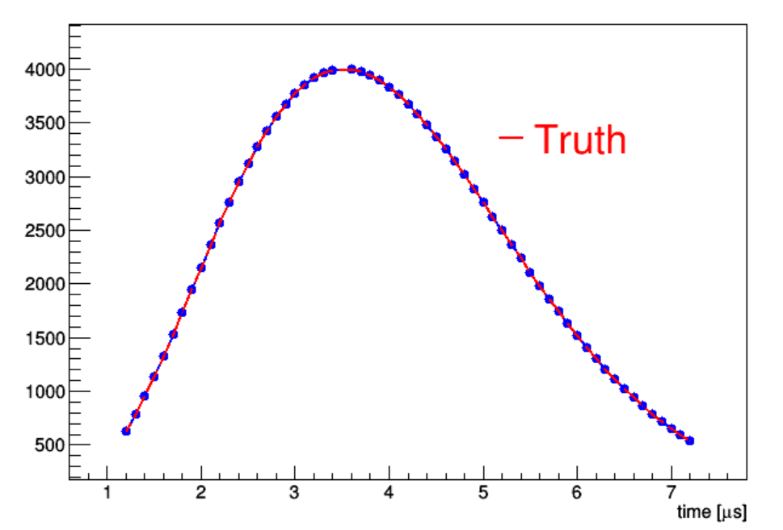

MC validation of the degeneracy
Given a same charge input, the waveform predictions are close (<1 ADC) for
True response and NL
A “best-fit” effective response and NL
NL bias in “best-fit” is not a problem!
By Carlos
ADC_{measure}
Fitted response $⊗$fitted NL
True response $⊗$true NL

Slide 20
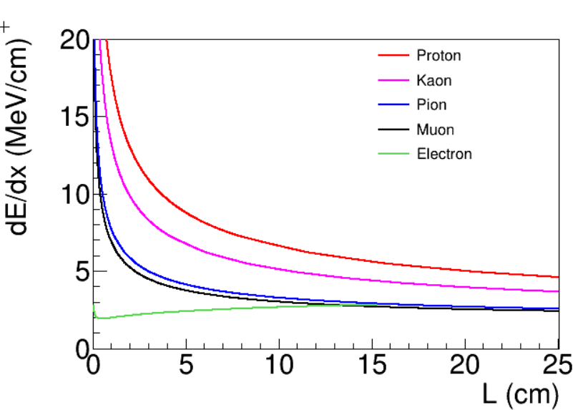
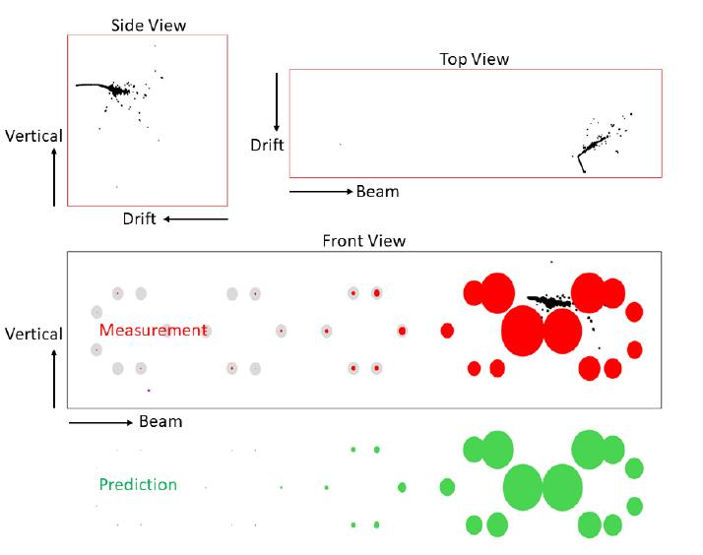
Discussion: ADC impact on physics analysis
ADC nonlinearity calibration is necessary for a precise extraction of ionized electrons
Presumably, an important input for any analysis related with energy/charge
e.g., particle identification, TPC/light matching
Particle Identification
TPC/Light Matching
Xin’s talk
Brooke’s talk

Slide 21
Summary
Cold electronics is essential for LArTPC experiments
Sticky code mitigation
An interpolation approach through FT is proposed and studied in protoDUNE
ADC nonlinearity
A calibration strategy was proposed and preliminarily studied in simulation

